Slide 1
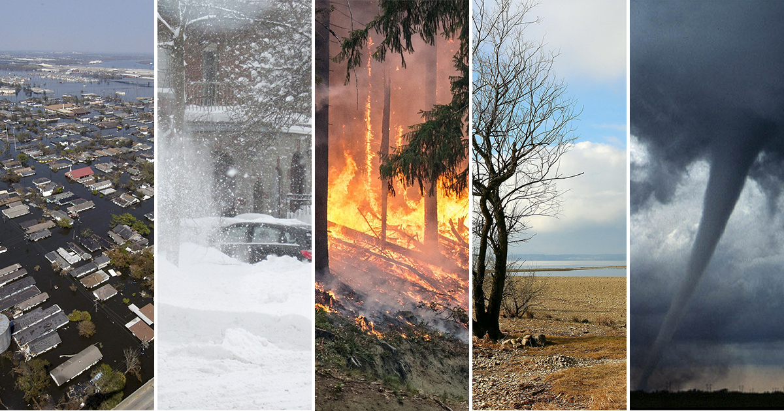
Disaster
Risk Predictive Model

Slide 2
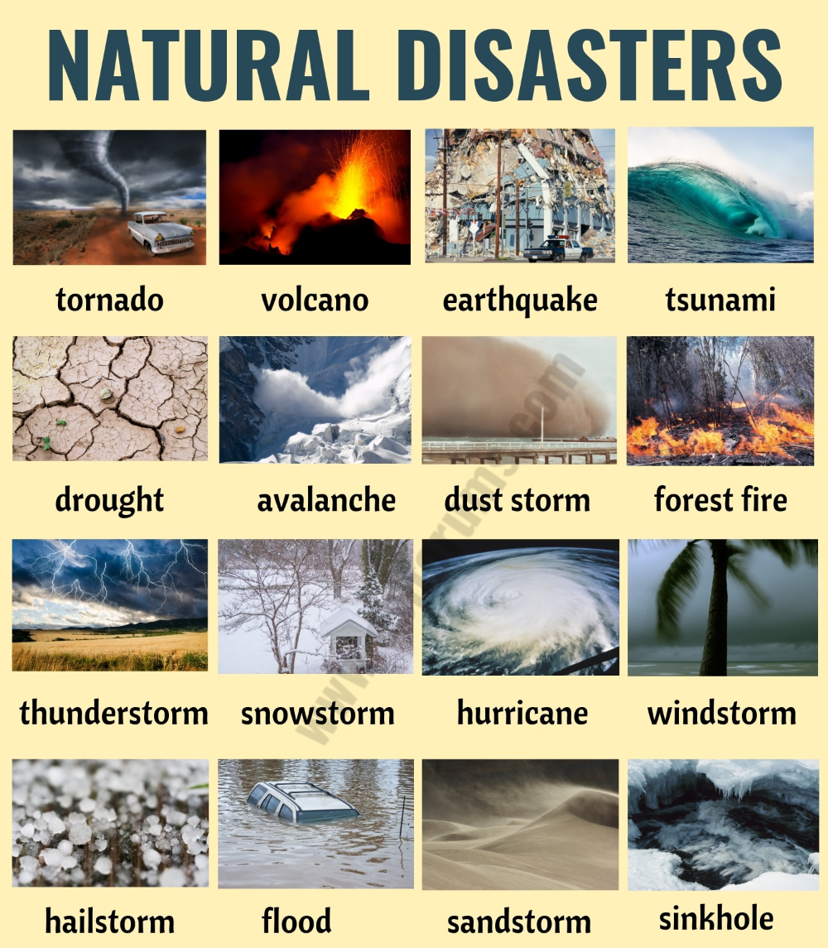
PROJECT SUMMARY
This project aims to assess and mitigate disaster risks by evaluating WRI, Vulnerabilities, Exposures, and Susceptibility of natural disasters in a specified region or globally. The assessment will utilize data from multiple sources, including satellite imagery, historical disaster records to provide actionable insights for risk reduction
We are using our Machine Learning technique to identify Disaster risk by checking some parameters
In this project, we have worked on disaster risk analysis using some Python libraries for visualization like NumPy, pandas, matplotlib, Seaborn and sklearn

Slide 3

PURPOSE OF THE PROJECT
To analyse the distribution of WRI scores across different countries.
To investigate factors that correlate with high or low WRI scores.
To develop predictive models for forecasting future WRI scores based on historical data.
To provide actionable insights and recommendations for disaster management.

Slide 4
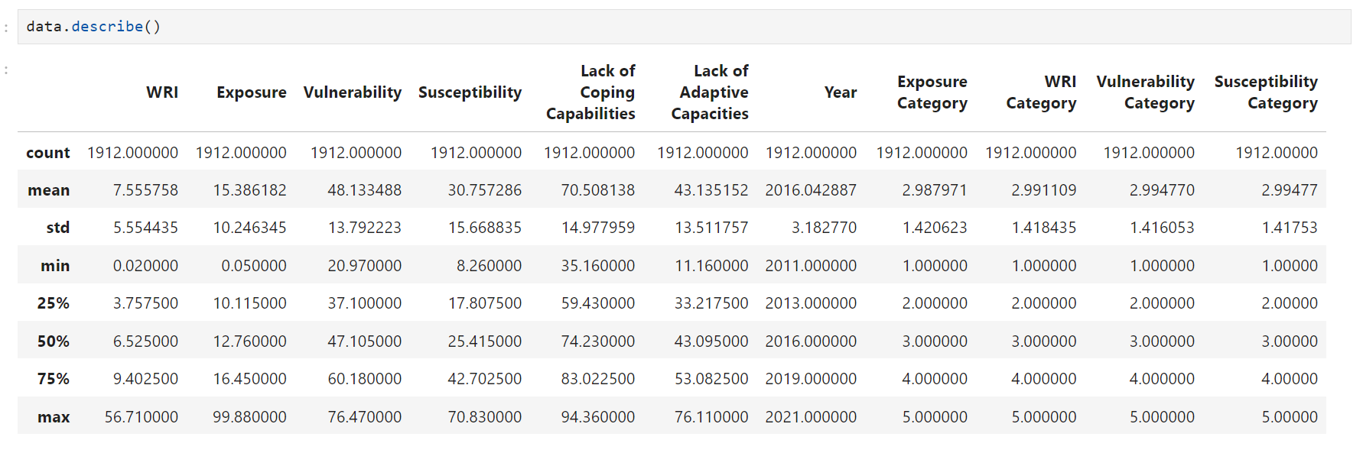
SOURCE OF DATA USED
Data Source - Data is taken from Kaggle. There are several attributes in the data set on the basis of which we are predicting, analyzing, visualizing, and detection of disaster risk.
Link - https://www.kaggle.com/datasets/tr1gg3rtrash/global-disaster-risk-index-time-series-dataset

Slide 5
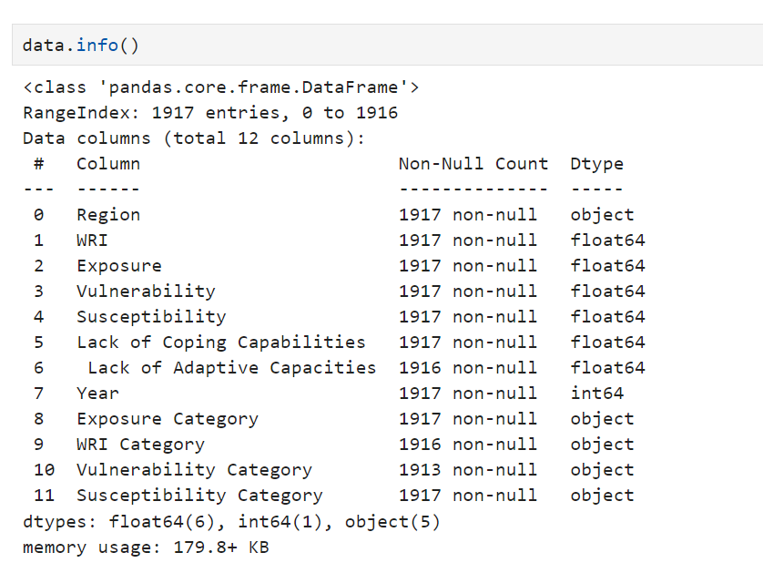
DATA BEFORE CLEANING

Slide 6
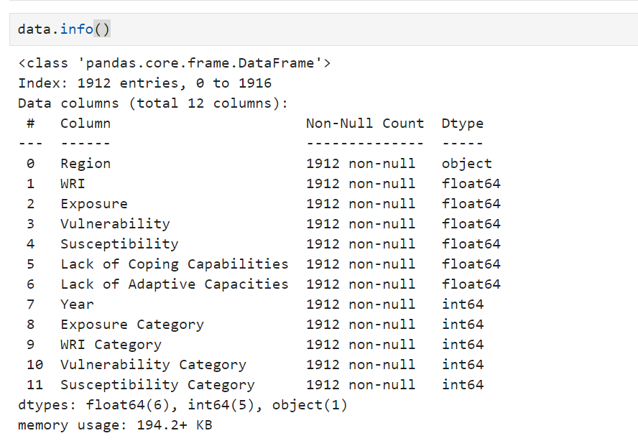
DATA AFTER CLEANING

Slide 7
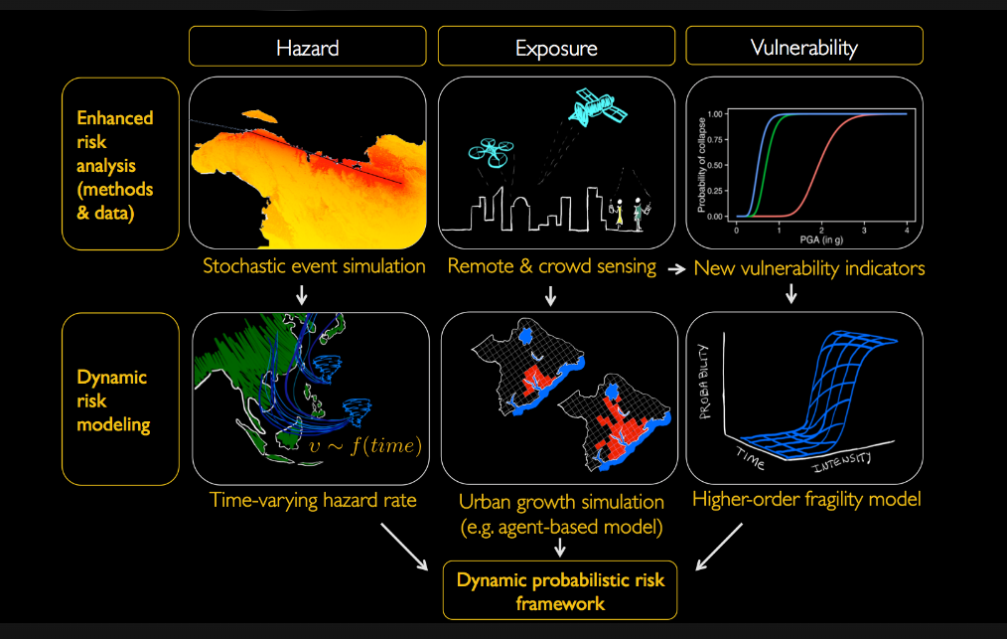
DATA VISUALIZATION

Slide 8
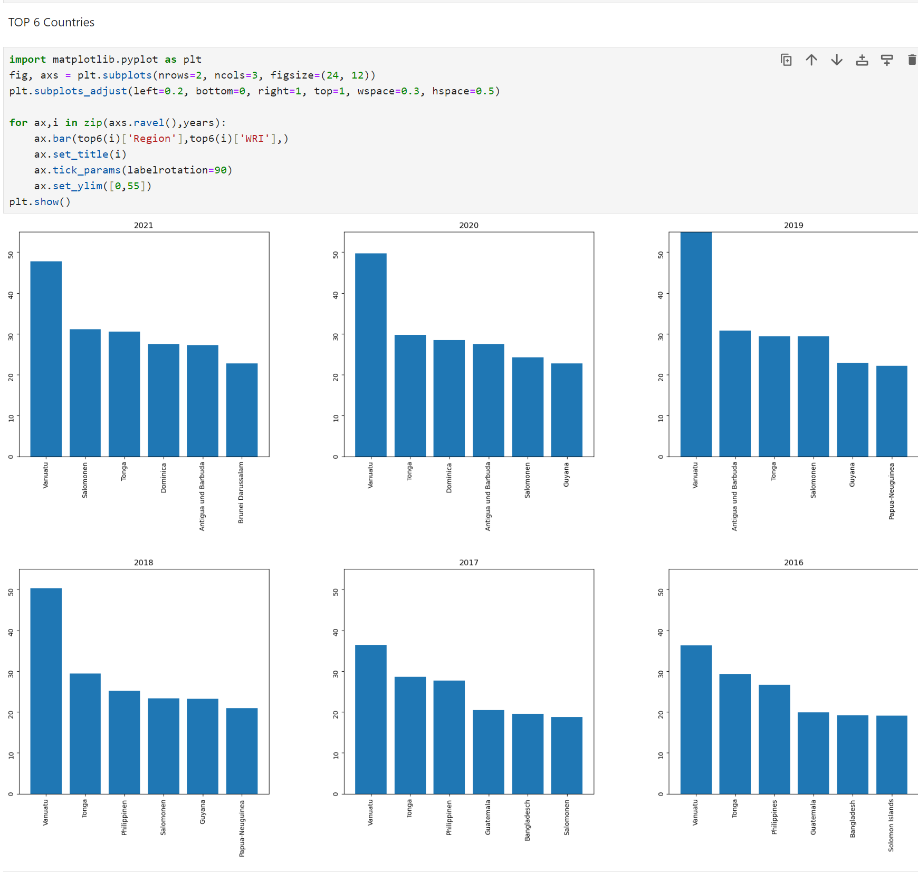
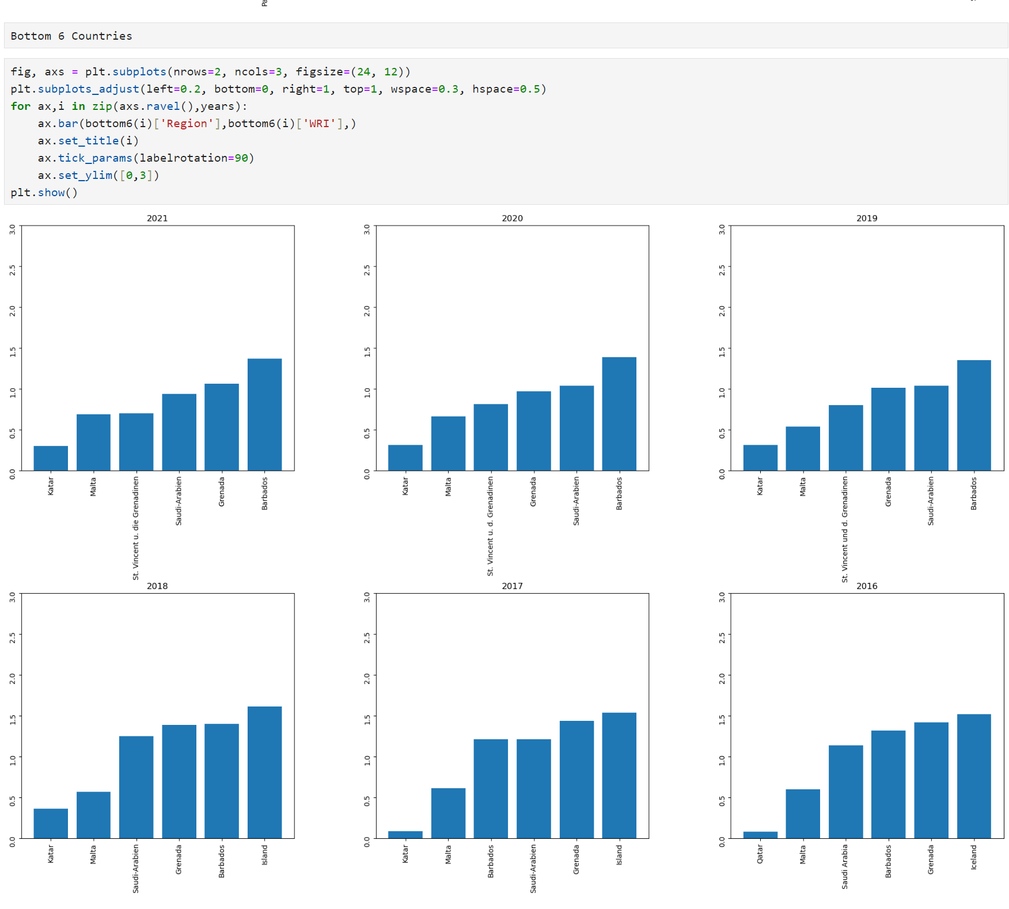
Top 6 Countries with respect to year
Bottom 6 Countries with respect to year
Fig.Bar chart for top 6 countries
Fig.Bar chart for bottom 6 countries
9

Slide 9
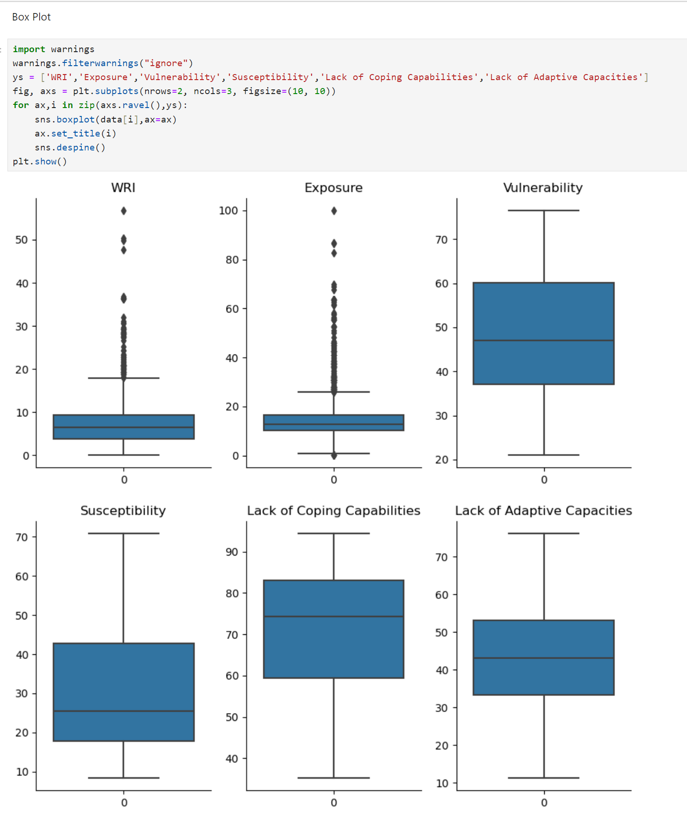
Fig. BoxPlot

Slide 10
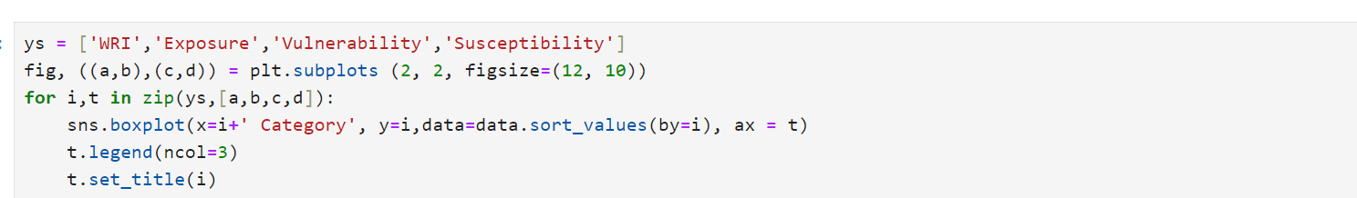
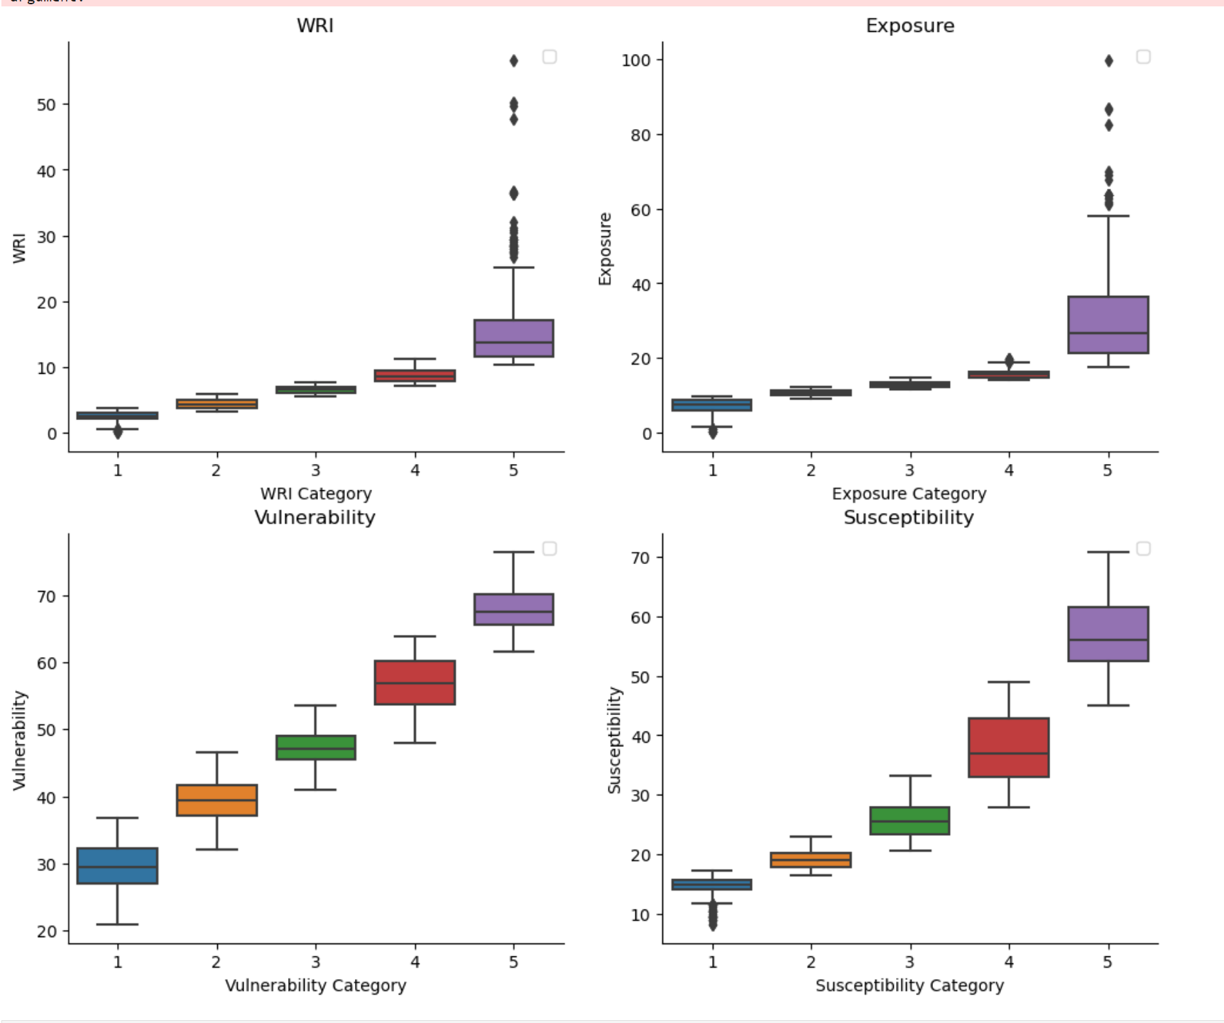
Fig. Box Plot with respect to categories

Slide 11
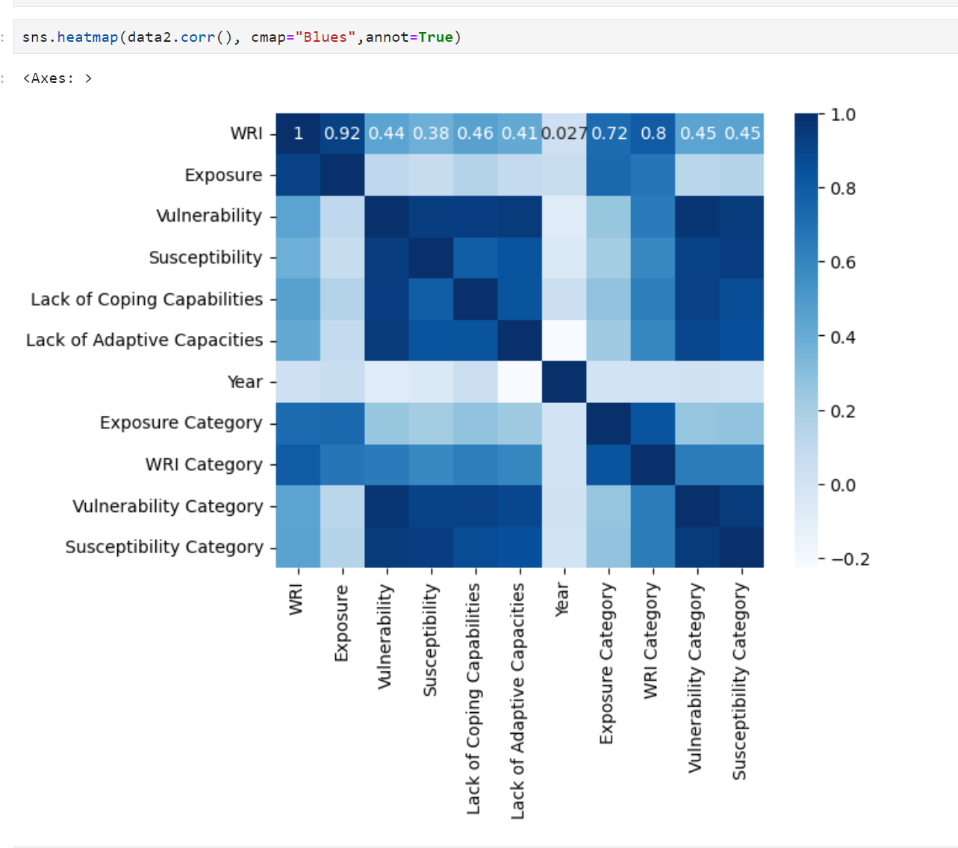
Fig. Heatmap Correlation of each feature in the dataset

Slide 12
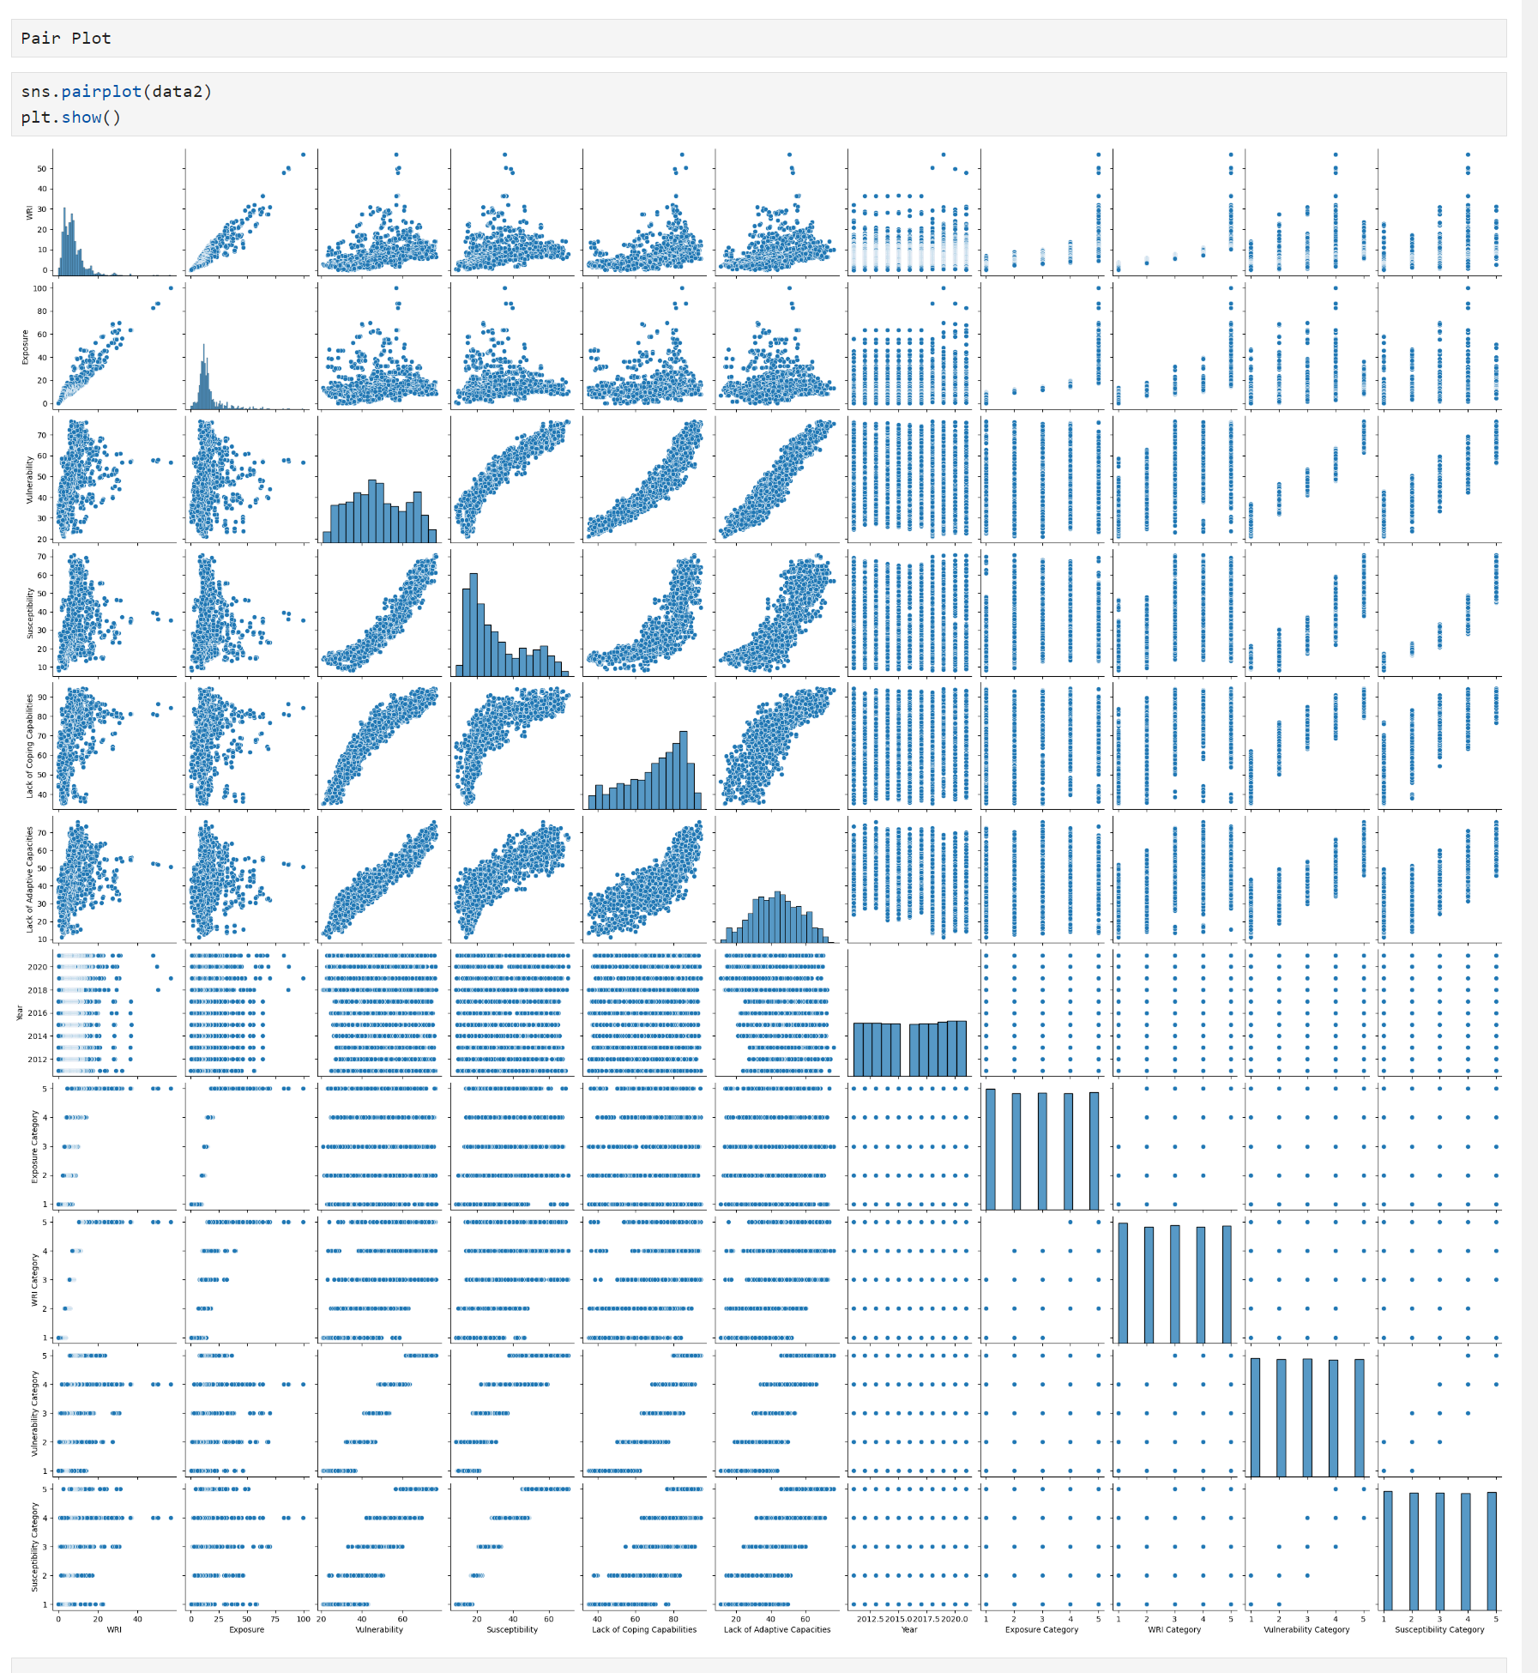
Fig. Pair Plot

Slide 13
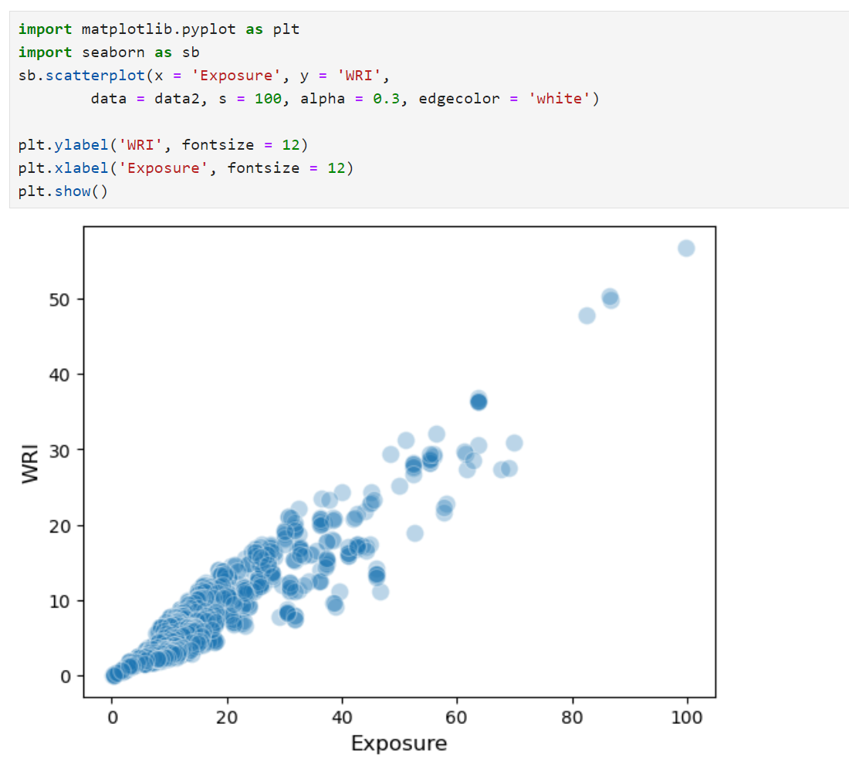
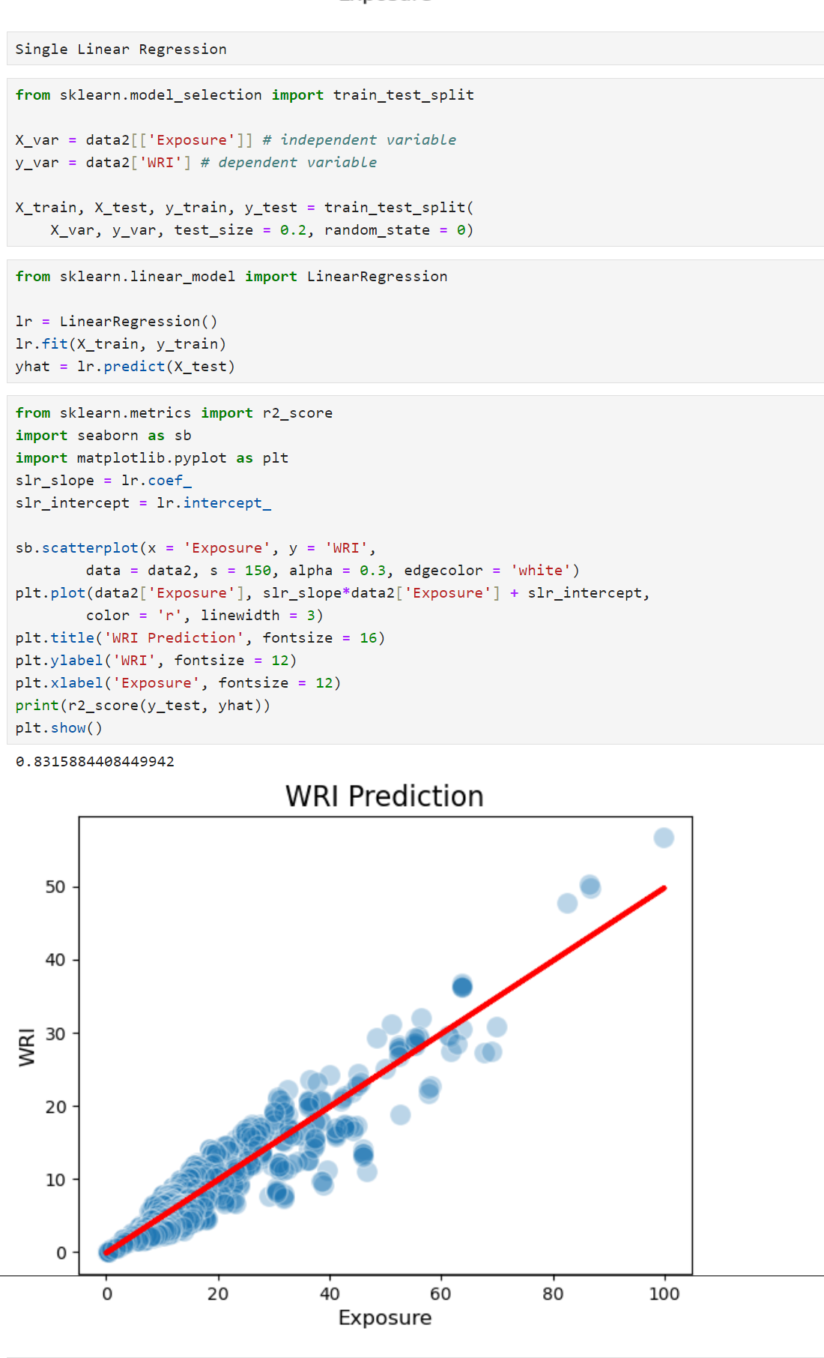
The accuracy is 83%, which is significantly lower than the classification.
Therefore, it proceeds after adding more diverse columns with multiple linear regression

Slide 14
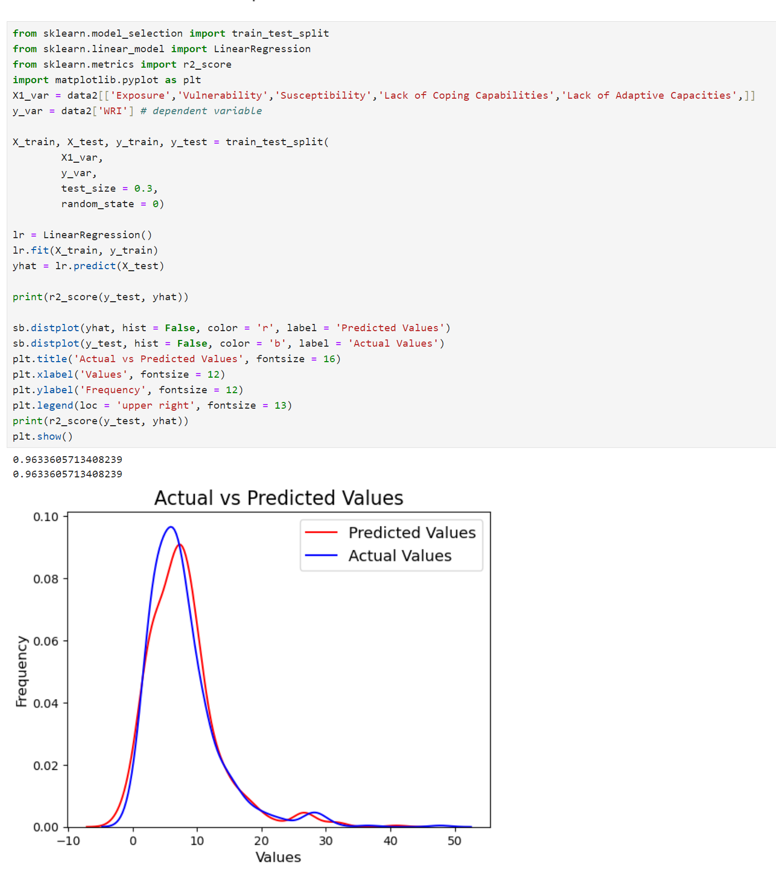
Fig. Actual and Predicted values

Slide 15
CONCLUSION
It stresses that the Sustainable Development Goals (SDGs) can only be achieved with increased action to build resilience to systemic risk.
As actual and predictive analysis graph shows significant rise in disasters as from 83% to 96% , 13% rise.
It stresses the significance of addressing vulnerability’s root causes
The best defense against future shocks is to transform systems now, to build resilience by addressing climate change and to reduce the vulnerability, exposure.
If no effective action is taken, the risk may remain high or increase.

Slide 16

TEAM MEMBERS
1. Ashwini Shinde
2. Alka Patil
3. Samruddhi Nitave

